Slide 1

Intro to Programming with C#

Slide 2
Table of contents
What && Why?
How it works?
Libraries

Slide 3
Why C#?
C# is one of the languages available in the .NET framework
​Most widely used CLI language
C# is very similar to other object-oriented programming languages, but it has a unique set of features:
Built-in functional programming capabilities
Built-in asynchronous programming capabilities
Native garbage collection
Type safety

Slide 4
Why C#?
In short
​​​Supported by Microsoft
​Very popular
Not very steep learning curve
Type safe
Built in memory management

Slide 5

Why C#?
According to a developer's survey in Stack Overflow for 2020
Most beloved programming languages

Slide 6

What is .NET ?
.NET is a free, open-source, and cross-platform for building modern, scalable, and high-performance desktop, web, cloud, and mobile applications. The current version of .NET is .NET 5.0, which is the successor of .NET Core 3.1 and .NET Framework 4.6. Prior to .NET 5.0, .NET had two versions, .NET Framework, and .NET Core, but in this version, both have merged and now there is only version.
.NET is a single unified platform to build desktop, web, cloud, mobile, gaming, IoT, and AI apps. The .NET ecosystem has a single common library, runtime, language compilers, and tools.

Slide 7
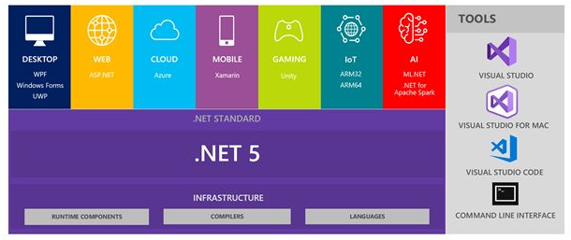

Slide 8
The following is a list of .NET components:
Application frameworks and libraries
.NET Standard
Runtime Components
Language Compilers
Languages – C#, F#, and Visual Basic
Tools - Visual Studio, Visual Studio for Mac, Visual Studio Code, and Command Line Interface (CLI) are tools used to build, test, and deploy .NET applications.

Slide 9
Why .NET?
Today, we build software to target various devices and platforms. Devices include desktops, laptops, tablets, and smartphones. Platforms are Windows, Linux, and Mac. Besides these common devices and platforms, there are more devices and platforms out there. Internet of Things (IoT), cloud platforms, gaming devices, TVs, refrigerators, and cars are other popular devices that run on software.

Slide 10
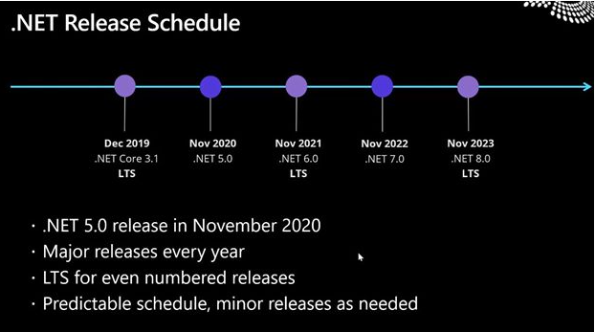
.NET current version and future releases

Slide 11
How it works?
Hit
Ctrl+F5
or Build => Build Solution
What does a Console Application produce?
Any ideas?
ANSWER: .exe file

Slide 12
How it works?
Where to find it
It is in .bin folder of your project
An .exe file with the name of the project
But how does Visual Studio knows what to do?
It is not magic
It just runs a program (compiler) which builds the project and creates the .exe file for you

Slide 13
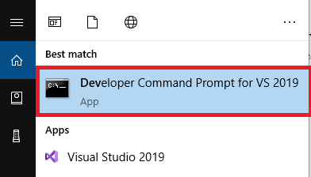
How it works?
Just open the Developer Command Prompt for VS2019
It is enhanced Command Prompt in Windows
Navigate to the folder with your project
type Program.exe in the console

Slide 14
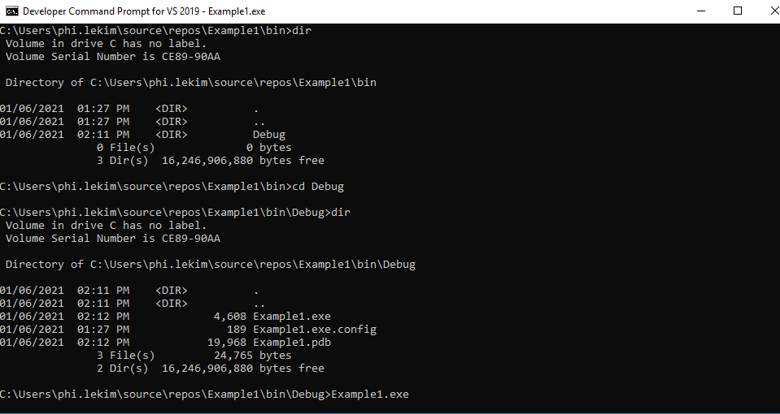

Slide 15
Libraries
Does anyone here knows how to calculate very big numbers in C#?
That's right - BigInteger
How we add this library?
We add System.Numerics as a Reference

Slide 16
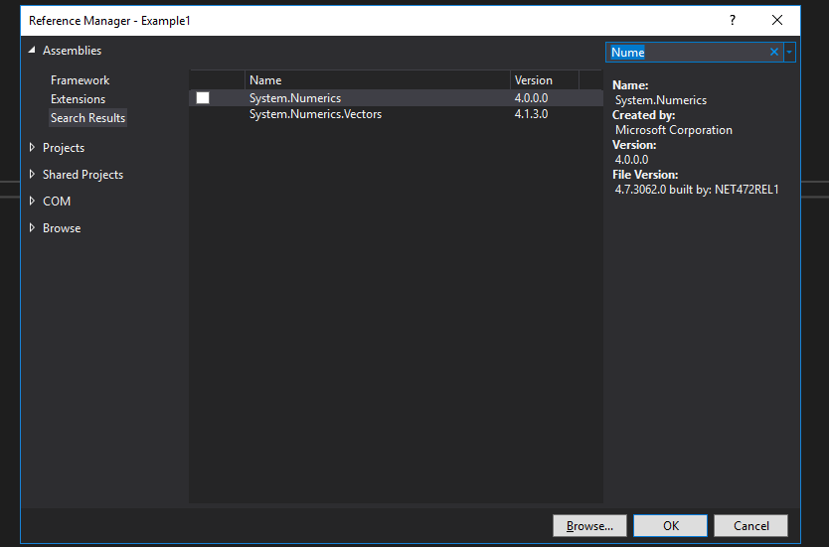

Slide 17
NuGet
What actually is the library in C#
It is just a .dll file
Don't remember the extension for now
It is just a program without a Main method
​But how do we add more libraries?
There is a package manager called NuGet

Slide 18
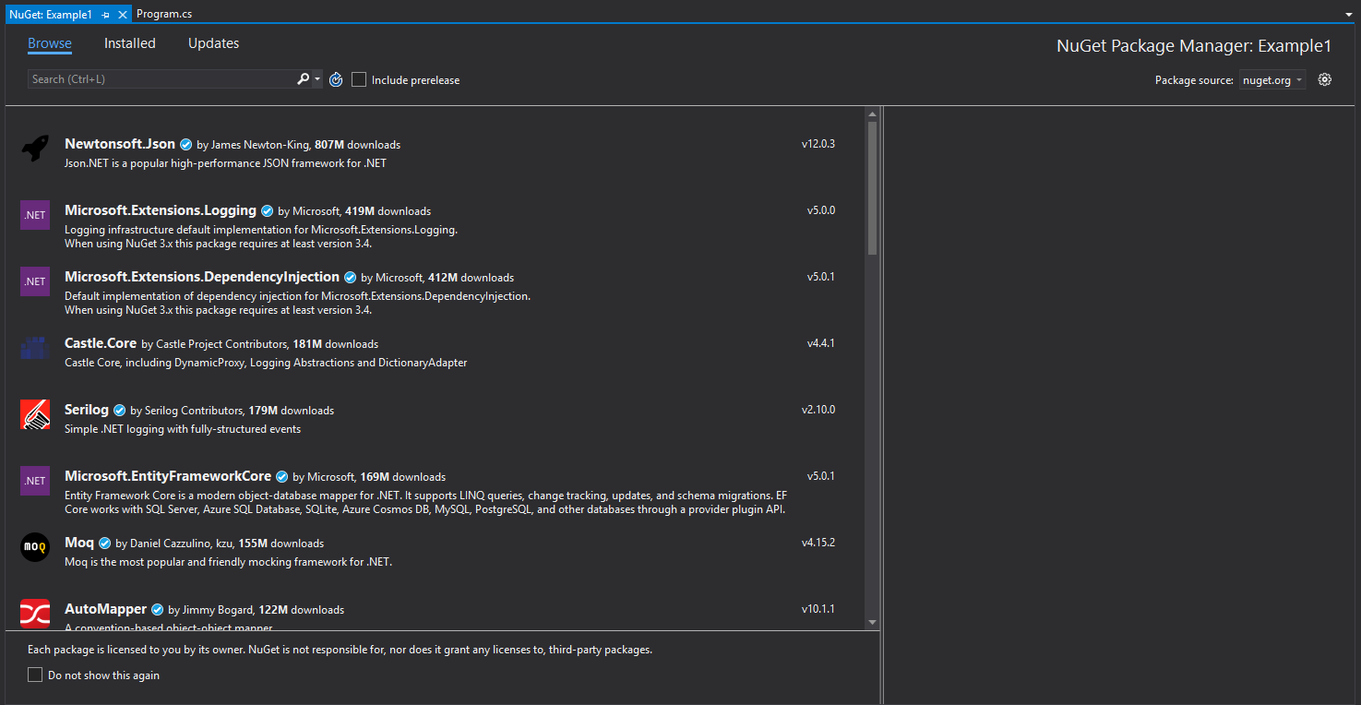
NuGet

